Slide 1
Turbidity and Water

Slide 2
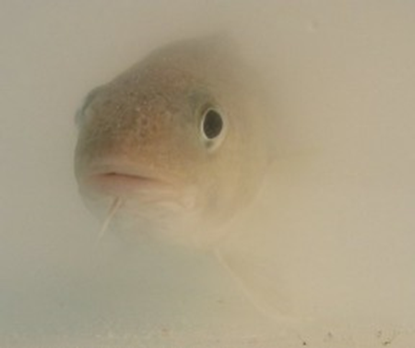
Turbidity is a measure of
water clarity, how much the
material suspended in water
decreases the passage of light
through the water.
It is an optical characteristic of water and is an expression of the amount of light that is scattered by material in the water when a light is shined through the water sample.
The higher the intensity of scattered light, the higher the turbidity.

Slide 3
Suspended materials include soil particles (clay, silt, and sand), algae, plankton, microbes, and other substances.
These materials are typically in the size range of 0.004 mm (clay) to 1.0 mm (sand).
Turbidity can affect the color of the water.

Slide 4
Higher turbidity increases water temperatures because suspended particles absorb more heat.
This, in turn, reduces the concentration of dissolved oxygen (DO) because warm water holds less DO than cold.
Higher turbidity also reduces the amount of light penetrating the water, which reduces photosynthesis and the production of DO.

Slide 5
Suspended materials can clog fish gills, reducing resistance to disease in fish, lowering growth rates, and affecting egg and larval development.
As the particles settle, they can blanket the stream bottom, especially in slower waters, and smother fish eggs and benthic macroinvertebrates.

Slide 6
Sources of turbidity include:
•Soil erosion
•Waste discharge
•Urban runoff
•Eroding stream banks
•Large numbers of bottom feeders (such as carp), which stir up bottom sediments
•Excessive algal growth.

Slide 7
Turbidity is not a measurement of the amount of suspended solids present or the rate of sedimentation of a steam since it measures only the amount of light that is scattered by suspended particles
Turbidity is generally measured by using a turbidity meter

Slide 8
Another approach is to measure transparency (an integrated measure of light scattering and absorption) instead of turbidity.
Water clarity/transparency can be measured using a Secchi disk or transparency tube.
The Secchi disk can only be used in deep, slow moving rivers or in lakes.

Slide 9
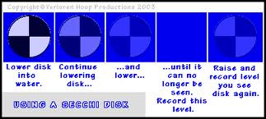
A Secchi disk is a black and white disk that is lowered by hand into the water to the depth at which it vanishes from sight .
The distance to vanishing is then recorded.
Taken from: www.paddling.net

Slide 10
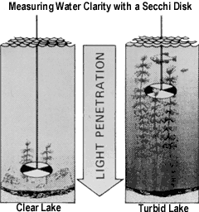
The clearer the water, the greater the distance.
Taken from: www.eaglelakewillmar.com

Slide 11
Regular monitoring of turbidity can help detect trends that might indicate increasing erosion in developing watersheds.
Turbidity is closely related to stream flow and velocity and should be correlated with these factors. Comparisons of the change in turbidity over time, therefore, should be made at the same point at the same flow.

Slide 12
High concentrations of particulate matter affect light penetration and productivity, recreational values, and habitat quality, and cause lakes to fill in faster.
In streams, increased sedimentation and siltation can occur, which can result in harm to habitat areas for fish and other aquatic life.
Particles also provide attachment places for other pollutants, notably metals and bacteria. For this reason, turbidity readings can be used as an indicator of potential pollution in a water body.

